Slide 1
UNIT 5:
DESIGN OF MECHATRONICS SYSTEM 12
Stages in designing Mechatronics Systems – Traditional and Mechatronic Design – Possible Design Solutions. Case studies of Mechatronics systems- Pick and place Robot- Autonomous mobile robot Wireless suriviellance balloon- Engine Management system- Automatic car park barrier.

Slide 2
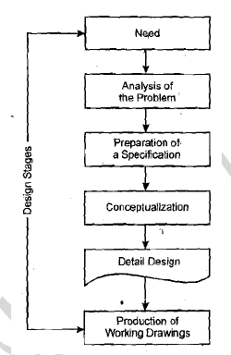
Stages in designing Mechatronics Systems

Slide 3
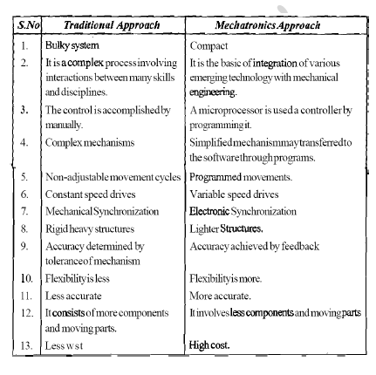
Traditional and Mechatronics Design

Slide 4
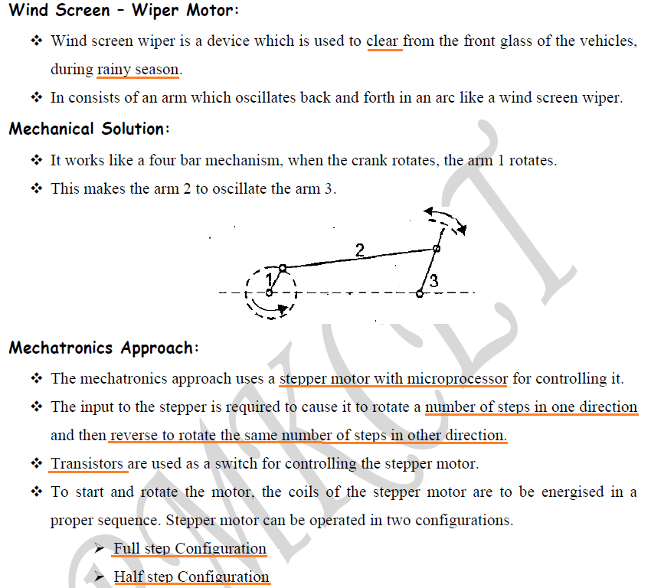
POSSIBLE DESIGN SOLUTIONS

Slide 5
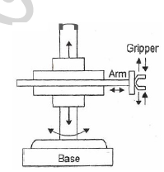
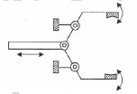
Case studies of Mechatronics systems Pick and place Robot

Slide 6
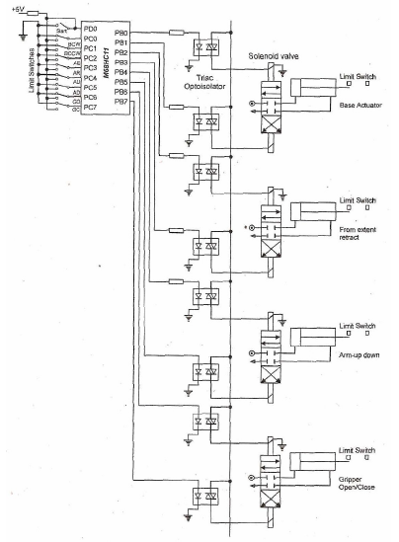

Slide 7
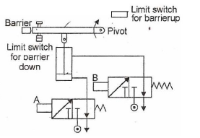
Automatic Car Park System

Slide 8
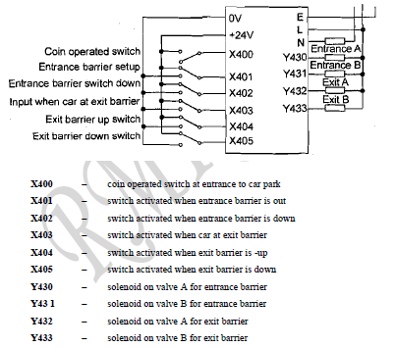

Slide 9
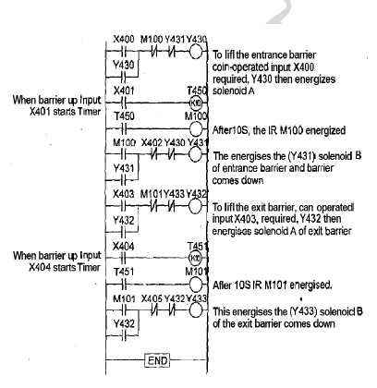

Slide 10
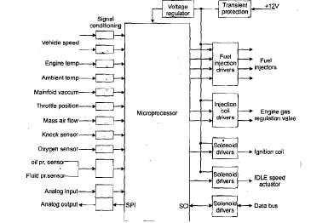
Engine Management System

Slide 11
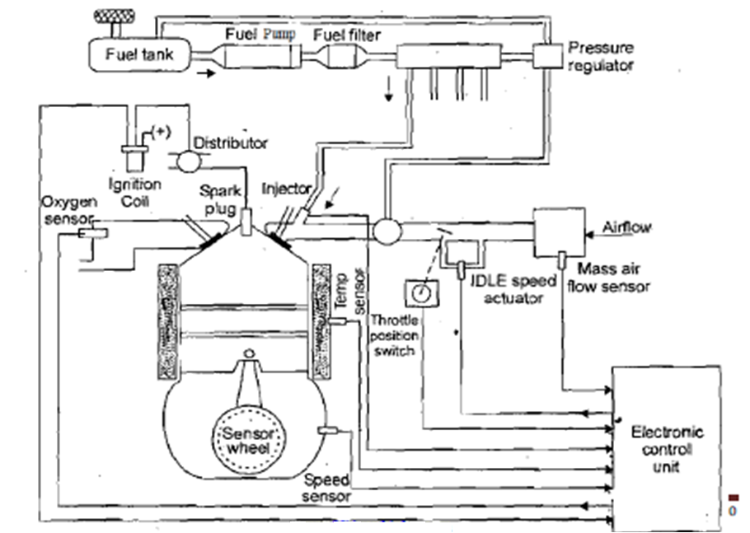

Slide 12
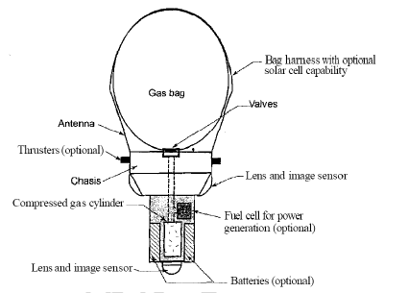
Wireless Surveillance Balloon

Slide 13
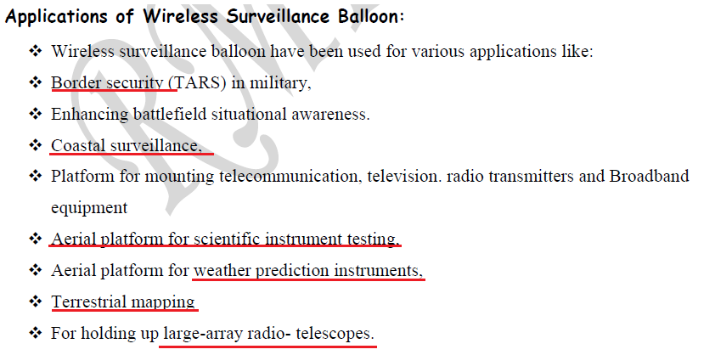

Slide 14
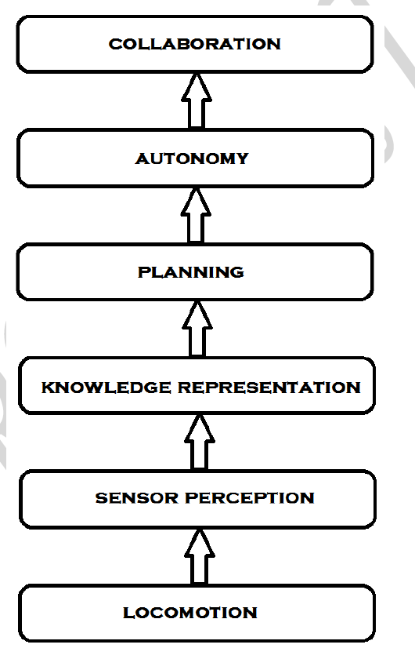
Autonomous Mobile Robot

