Slide 1
UNIT 4: PROGRAMMING LOGIC CONTROLLERS 12
Programmable Logic Controllers – Basic Structure – Input / Output Processing – Programming – Mnemonics – Timers, Internal relays and counters – Shift Registers – Master and Jump Controls – Data Handling – Analogs Input / Output – Selection of a PLC

Slide 2
Programmable Logic Controllers
Definition of PLC:
Programmable logic controller (PLC)
Program is a specially designed digital operating microprocessor-based controller that uses a programmable memory for internal storage of instructing and for implementing function such as logic, sequencing, timing, counting and arithmetic in order to control machines and processes.

Slide 3
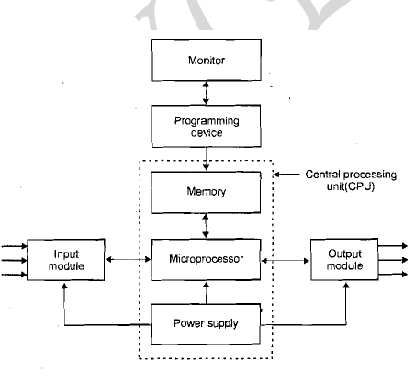
BASIC COMPONENTS:
Processor
Memory
Power Supply
Input I Output modules
Programming device
Monitor

Slide 4
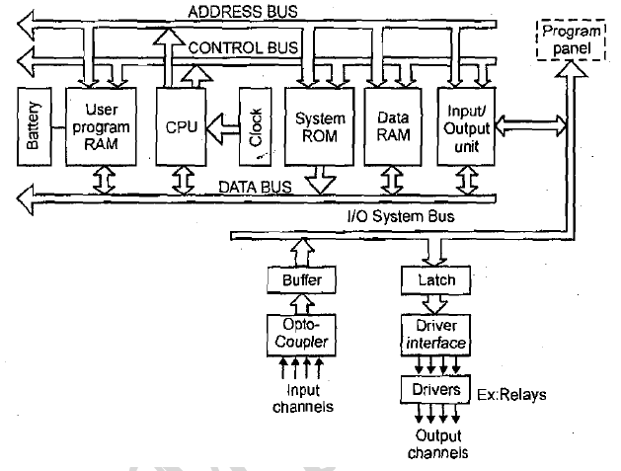
BASIC STRUCTURE OF A PLC SYSTEM

Slide 5
INPUT / OUTPUT PROCESSING
The sourcing and sinking are used to describe the way in which DC devices are connected to PLC
Sourcing:
If a switch is connected to the positive of the battery and current flows from positive to negative, it is said to be the sourcing the current. So, the input device receives current from the input module.

Slide 6
Sinking:
If a switch is connected to the negative of the battery and current flows from positive to negative, by conventional current flow direction, it is said to be the sinking for Current. For the PLC output unit, the current flows from output device to the output module

Slide 7
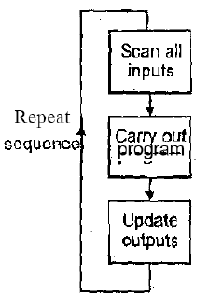
STEPS INVOLVED IN INPUT / OUTPUT PROCESSING

Slide 8
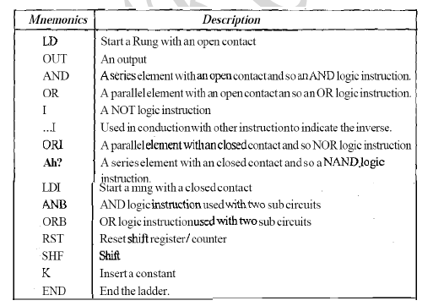
Mnemonics

Slide 9
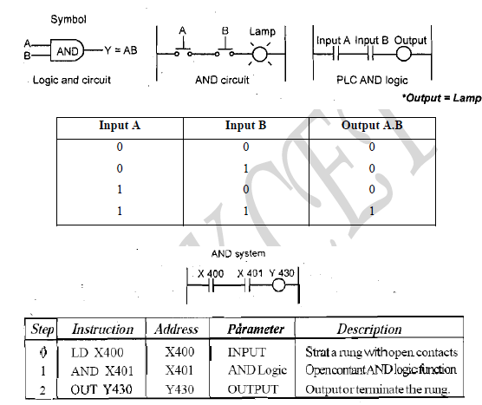
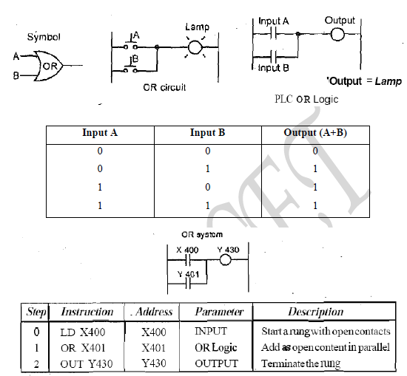
AND Logic Function:
OR Logic Function:

Slide 10
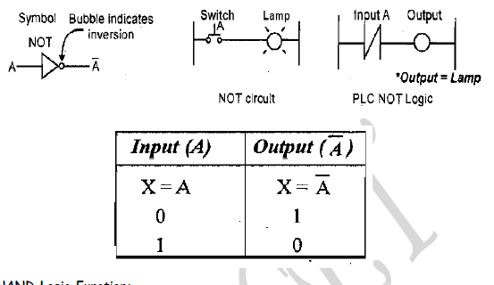
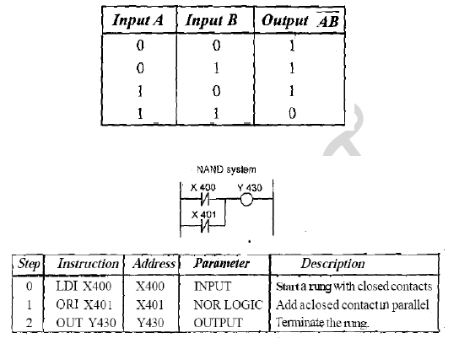
NOT Logic Function:
NAND Logic Function:

Slide 11
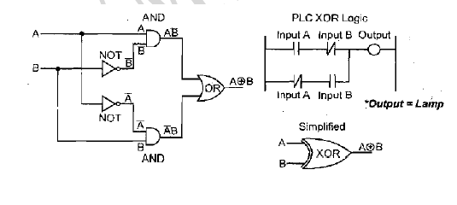
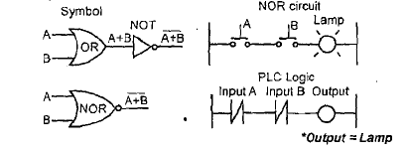
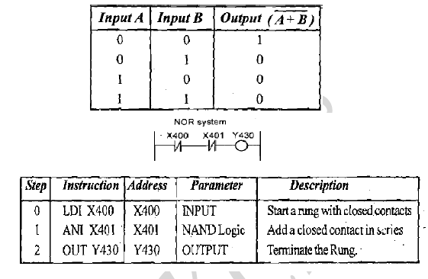
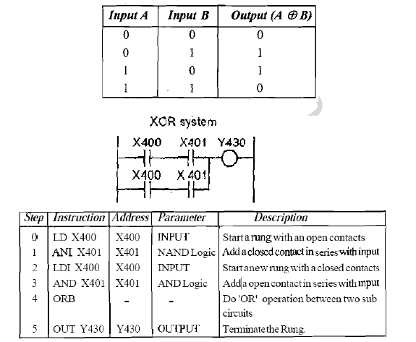
NOR Logic Function:
Exclusive OR (XOR) Logic Function:

Slide 12
Latching
It is the instructions that use momentary switches and program the PLC so that when we push one the output turns on and when we push another the output turns off. This would be the function of a latching instruction

Slide 13
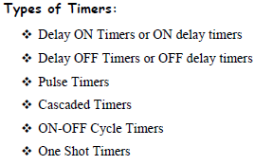
TIMER
It is a special counter ladder function that allows the PLC to perform timing operations based on a precise internal clock.
Delay ON Timers:
TON is used to denote ON-delay.

Slide 14
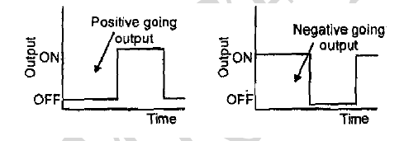
Delay OFF Timers:
Pulse Timers:
TOF is used to denote OFF-delay.

Slide 15
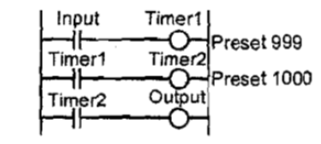
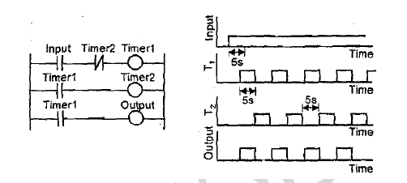
Cascaded Timers:
ON – OFF Cycle Timer:
Timers producing an output for some period and no output for some period and an output for some period.
Timers are linked together to give longer delay times which is easily achieved than just one timer.

Slide 16
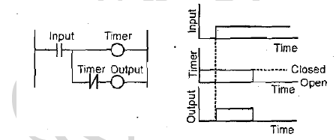
One Shot Timers:
One shot timers produces an output for a fixed length of some initiation input.

Slide 17
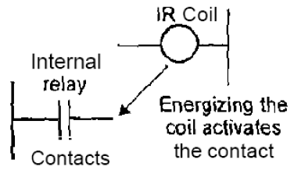
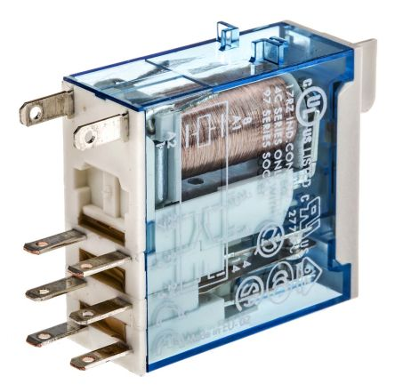
Internal relay
A relay is an electromagnetic switch operated by a relatively small electric current that can turn on or off a much larger electric current. The heart of a relay is an electromagnet
It can be very useful in the implementation of switching sequences.
It can be used when there are programs with multiple input conditions.

Slide 18
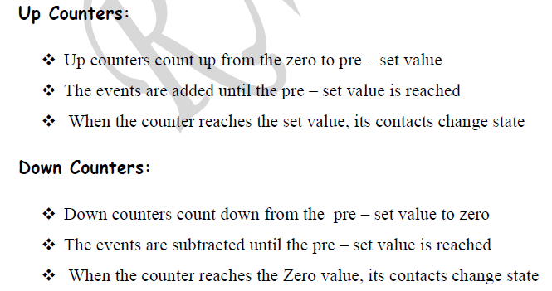
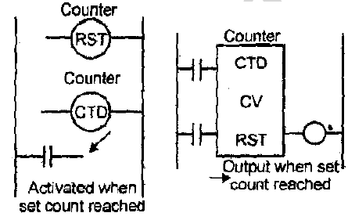
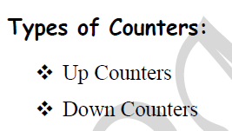
Counters
It is used to count a specified number of contact operations.

Slide 19
Shift Register:
A shift register is an electronic storage device that allows the stored bits of one relay to get shifted into another relay.

Slide 20
Data handling:
The steps involved in data handling with a PLC system are
Moving data from one memory location to another
Comparison of Magnitudes of data
Arithmetic operations
Data conversion

Slide 21
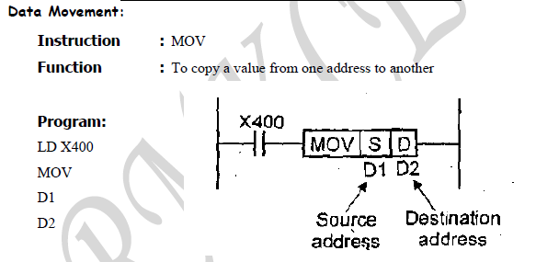

Slide 22
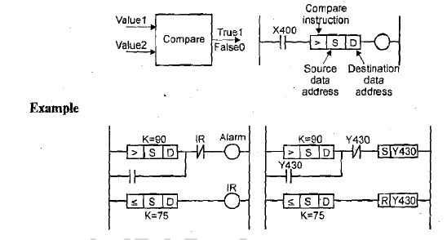
Data Comparison: It compare a pre – set value (1) to the input value (2)
Instruction :
< or LES
= or EQU
> or GRT
< or LEQ
≠ or <> or NEQ
> or GEQ

Slide 23
Data Arithmetic Operations:
It is the ability to carry out the arithmetic operations such as addition, subtraction, multiplication and division only.
They cannot carry out exponential functions.

Slide 24
Code Conversions:
All the internal operations in the CPU of a PLC are carried out through binary numbers.
When a decimal (input) signal is given, BCD conversion is used.
Similarly, when a decimal output is required, Decimal conversion is used.

Slide 25
