Slide 1
UNIT 3: SYSTEM MODELS AND CONTROLLERS 12
Building blocks of Mechanical, Electrical, Fluid and Thermal Systems, Rotational – Transnational Systems, Electromechanical Systems – Hydraulic – Mechanical Systems. Continuous and discrete process Controllers – Control Mode – Two – Step mode – Proportional Mode – Derivative Mode – Integral Mode – PID Controllers – Digital Controllers – Velocity Control – Adaptive Control – Digital Logic Control – Micro Processors Control

Slide 2
SYSTEM MODELS
These are equations which describe the relationship between the input and output of a system
Forecast behaviour of a system under specific conditions
Eg: Like a child building houses, car, cranes and etc
In this each building block is consider to have a single property or functions

Slide 3
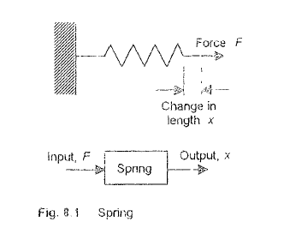
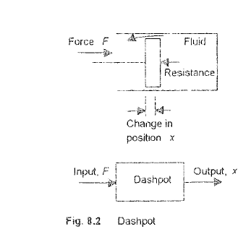
Building Blocks of Mechanical- Translational
SPRING
DASHPOT

Slide 4
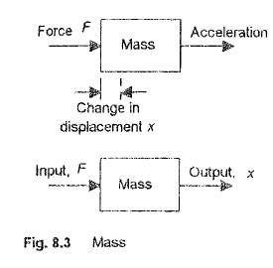

Slide 5
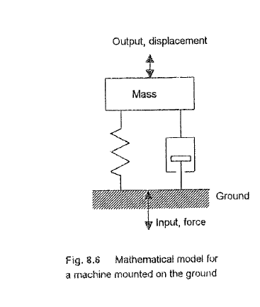
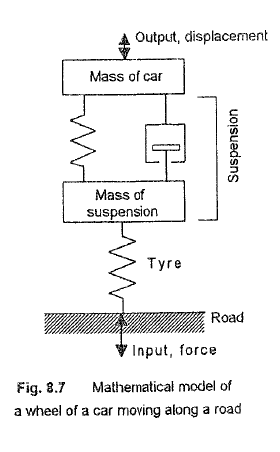

Slide 6
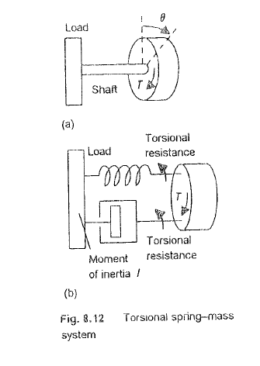
Building Blocks of Mechanical- Rotational

Slide 7
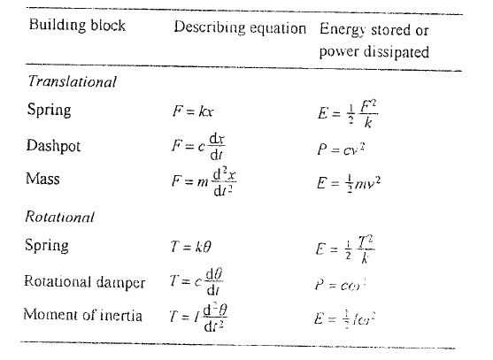

Slide 8
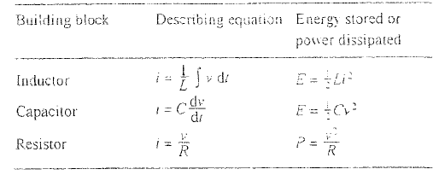
Building Blocks of Electrical

Slide 9
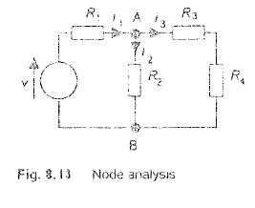
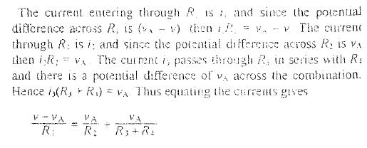

Slide 10
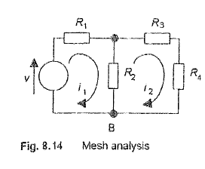
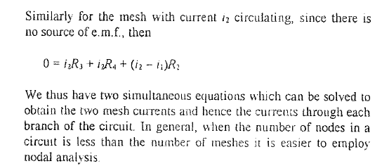

Slide 11
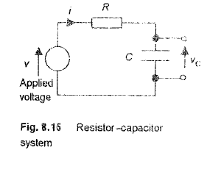
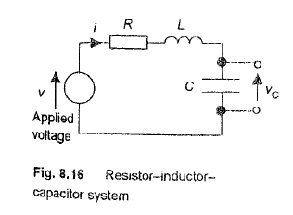
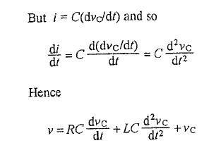

Slide 12
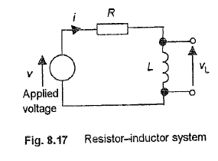
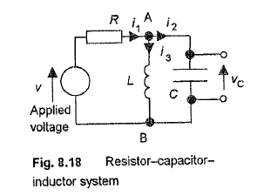
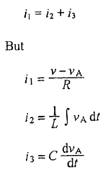
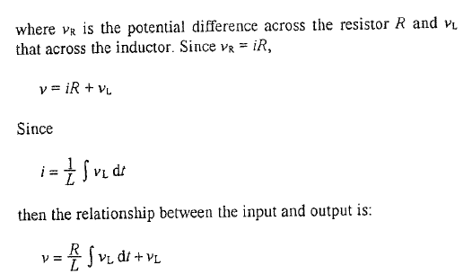
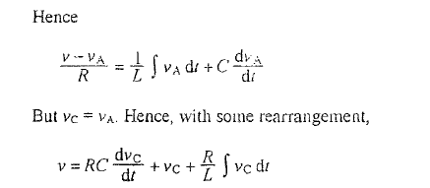

Slide 13
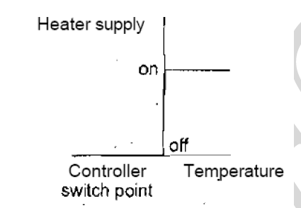
TYPES OF CONTROL MODES
The Two – Step Mode:
The two-step mode of control is the bimetallic thermoset at that might be used with a simple temperature control system.

Slide 14
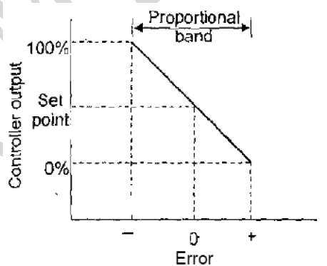
The Proportional Mode (P):
The proportional mode (P) which products a control action that is proportional to the error. The correcting signal thus becomes bigger the bigger the error.
The proportional mode, the size of the controller output is proportional to the size of the error.

Slide 15
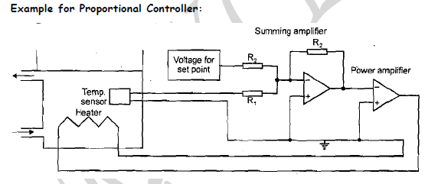

Slide 16
The Derivative Mode (D):
The derivative mode (D) which products a control action that is proportional to the rate at which are errors is changing
When there is a sudden change in the error signal the controller gives a large correcting signal
When there is a gradual change only a small corrections signal is produced

Slide 17
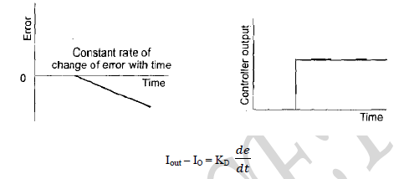

Slide 18
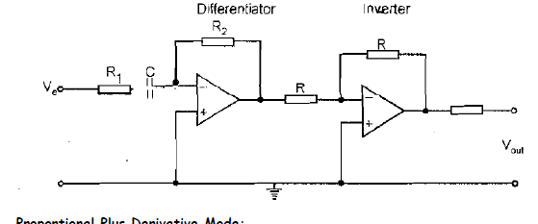

Slide 19
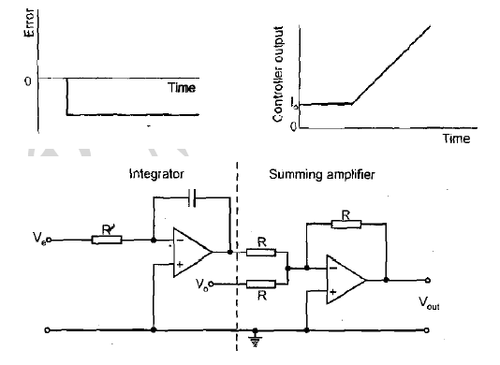
The Integral Mode (I):
The integral mode (I) which produces a control action that is proportional to the integral of the error with time.
It is one where the rate of change of the control output (I) is proportional to the input error signal.

Slide 21
Digital Controllers:
It is having microprocessor is in control of the closed-loop control system
The output is compared by the microprocessor with the set point value to give the error signal
Uses:
Compares it with the set value and establishes the error.
Samples the measured value.
Carries out calculations based on the error value and stored values of previous inputs and outputs to obtain the output signal

Slide 23
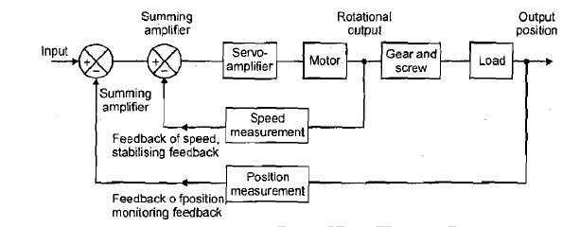
VELOCITY CONTROL:

Slide 24
ADAPTIVE CONTROL:
An adaptive control system which 'adapts' to changes and changes its parameters to fit the circumstances prevailing.
It is used to be adapted to fit the circumstances, modifying them as the circumstances change.
Stages of Adaptive Control System:
Starts to operate with controller conditions set on the basis of an assumed condition.
Desired performance is continuously compared with the actual system performance.
Control system mode and parameters are automatically and continuously adjusted.

Slide 25
Forms of Adaptive Control System:
Gain-scheduled control
Self – tuning
Model-reference adaptive systems

Slide 26
Gain-scheduled control:
It is sometimes referred to, pre-programmed adaptive control, pre-set changes in the parameters of the controller are made on the basis of some auxiliary measurement of some process variable

Slide 27
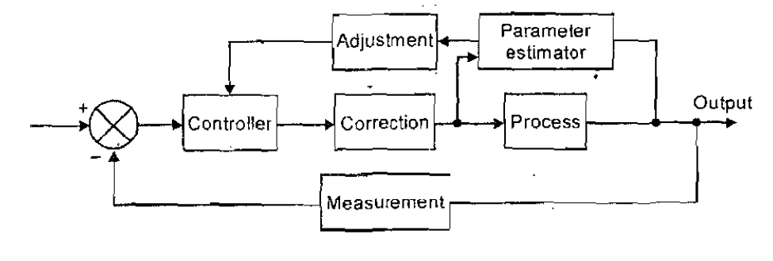
Self-tuning:
Self-tuning control the system continuously tunes its own parameters based on monitoring the variable that the system is controlling and the output from the controller.
It is often found in commercial PID controller

Slide 28
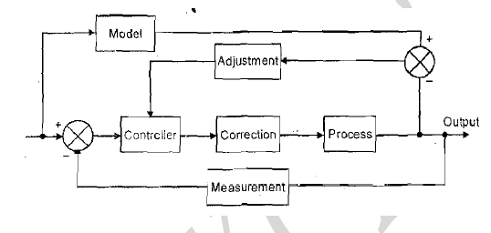
Model-Reference Adaptive Systems:
It is an accurate model of the system is developed
Difference between the actual output and the output from the model compared.

