Slide 1
UNIT 2: ACTUATION SYSTEMS
Pneumatic and Hydraulic Systems – Directional Control Valves – Rotary Actuators. Mechanical Actuation Systems – Cams – Gear Trains – Ratchet and pawl – Belt and Chain Drives – Bearings. Electrical Actuation Systems – Mechanical Switches – Solid State Switches – Solenoids – Construction and working principle of DC and AC Motors – speed control of AC and DC drives, Stepper Motors-switching circuitries for stepper motor – AC & DC Servo motors.

Slide 2
ACTUATION SYSTEM
Actuator is a component of a machine that is responsible for moving and controlling a mechanism or system, for example by opening a valve.
In simple terms, it is a "mover".
An actuator requires a control signal and a source of energy.

Slide 3
PNEUMATIC AND HYDRAULIC SYSTEMS
Hydraulic Systems
The working fluid in a hydraulic system is incompressible. Thus a hydraulic system can move large loads.
Pneumatic systems are open systems, always processing new air, and air is simply exhausted to the atmosphere. Hydraulic systems are closed systems, always recirculating the same oil.

Slide 4
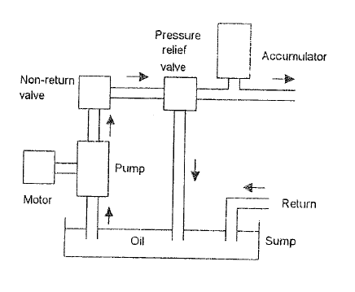

Slide 5
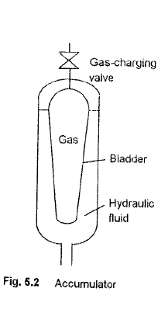

Slide 6
Pneumatic Systems
Pneumatic systems are designed to move loads by controlling pressurized air in distribution lines and pistons with mechanical or electronic valves.
Air under pressure possesses energy which can be released to do useful work.

Slide 7
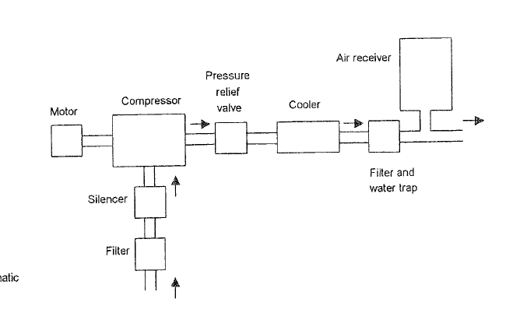

Slide 8
DIRECTIONAL CONTROL VALVES
Directional control valves perform only three functions:
stop fluid flow
allow fluid flow, and
change direction of fluid flow.
It is of two different forms,
Rotary spool type
Poppet type

Slide 10
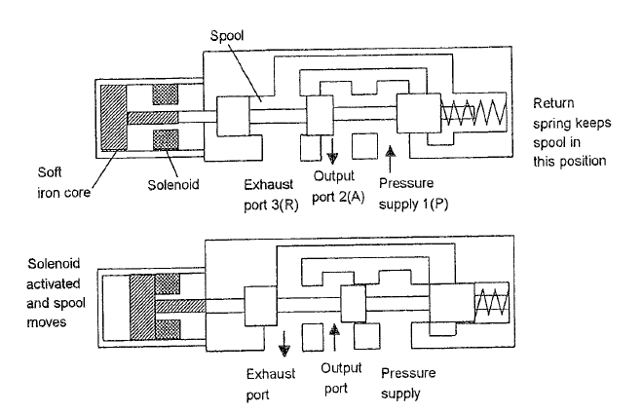
SPOOL TYPE SOLENOID OPERATED VALVE

Slide 11
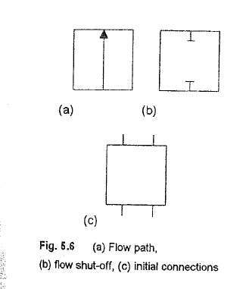
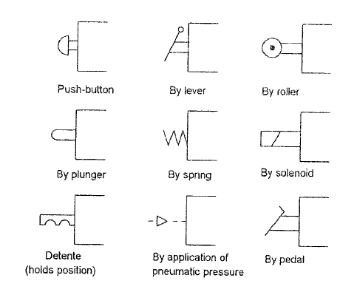
VALVE SYMBOLS

Slide 13
PILOT OPERATED VALVE

Slide 14
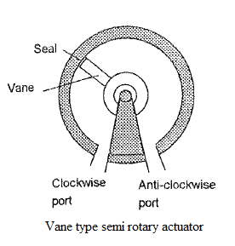
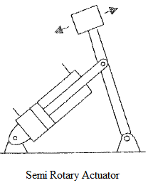
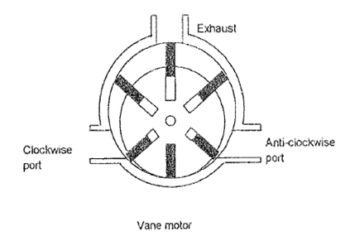
ROTARY ACTUATORS

Slide 15
MECHANICAL ACTUATION SYSTEM
A mechanical actuator functions to execute movement by converting one kind of motion, such as rotary motion, into another kind, such as linear motion.
An example is a rack and pinion.
The operation of mechanical actuators is based on combinations of structural components, such as gears and rails, or pulleys and chains.

Slide 16
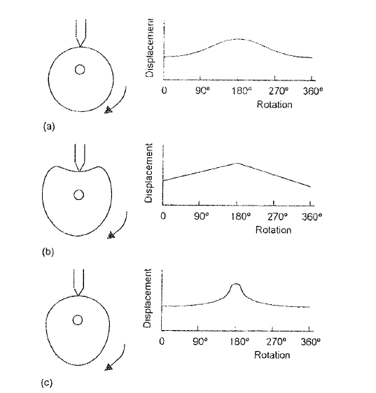
CAM

Slide 17
A cam is a rotating or sliding piece in a mechanical linkage used especially in transforming rotary motion into linear motion.
It is often a part of a rotating wheel (e.g. an eccentric wheel) or shaft (e.g. a cylinder with an irregular shape) that strikes a lever at one or more points on its circular path.

Slide 18
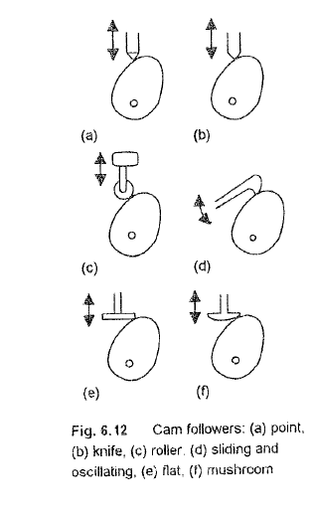

Slide 19
GEAR TRAINS
A gear train is a mechanical system formed by mounting gears on a frame so the teeth of the gears engage.
Gear teeth are designed to ensure the pitch circles of engaging gears roll on each other without slipping, providing a smooth transmission of rotation from one gear to the next.

Slide 20
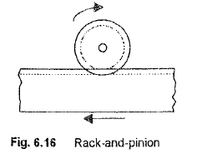
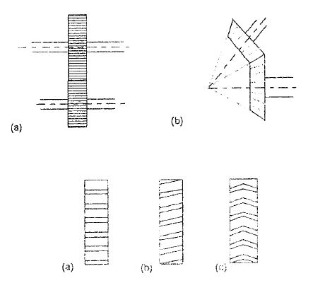
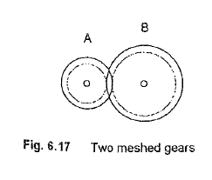

Slide 21
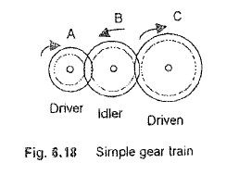
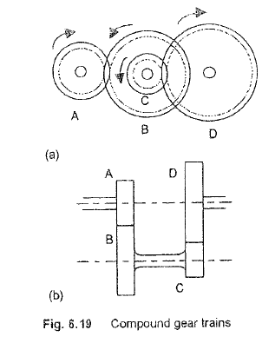

Slide 22
RATCHET AND PAWL

Slide 24
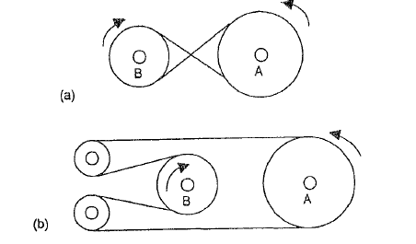
BELT DRIVES
Crossed belt drive
Open belt drive

Slide 25
It pair two rolling cylinders
Motion of one cylinder is transferred to other by belt
Types of belts
Flat Belt
Round Belt
V Belt
Timing Belt

Slide 26
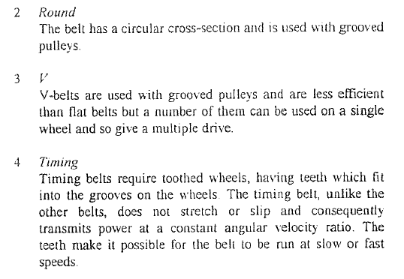

Slide 27
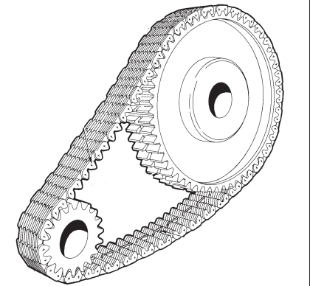
CHAIN DRIVES
Slips can be prevented by use of chains which lock into teeth on the rotating cylinders equivalent to the pair of intermeshing gear wheel
Similar to the simple gear train

Slide 28
BEARINGS
Bearings are machine elements which are used to support a rotating member viz., a shaft.
It transmit the load from a rotating member to a stationary member known as frame or housing.
They permit relative motion of two members in one or two directions with minimum friction, and also prevent the motion in the direction of the applied load.

Slide 29
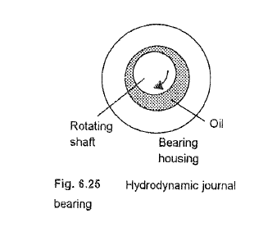
PLAIN JOURNAL BEARING

Slide 30
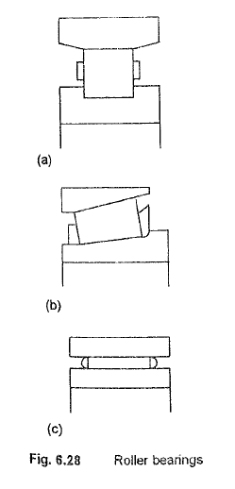
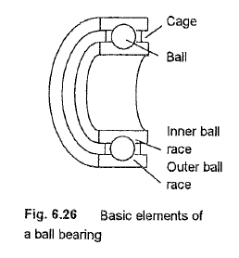

Slide 31
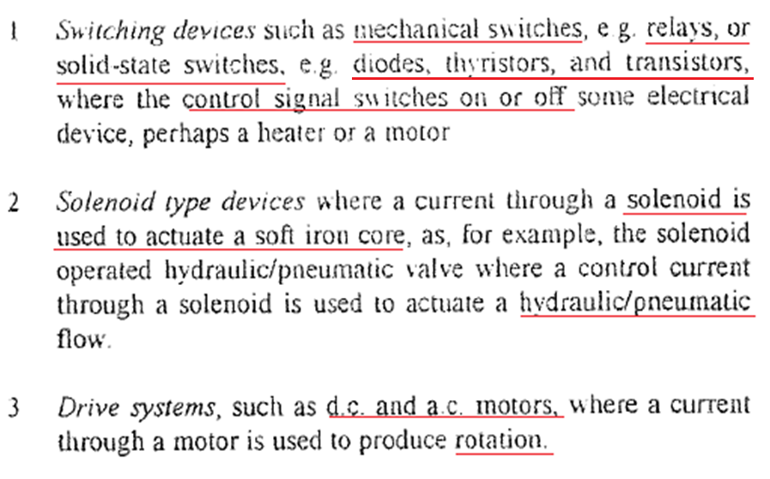
ELECTRICAL ACTUATION SYSTEMS (Electrical System)

Slide 32
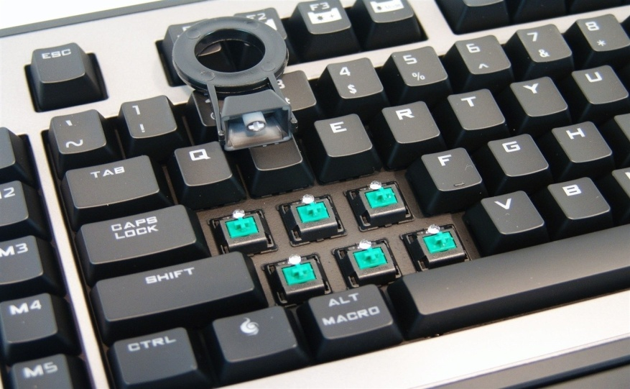
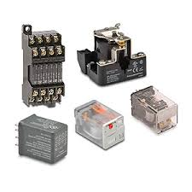
MECHANICAL SWITCHES
These are the elements often used as a sensors to give input to the systems
Eg: Keyboard & Relays

Slide 33
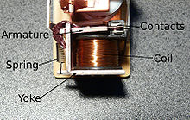
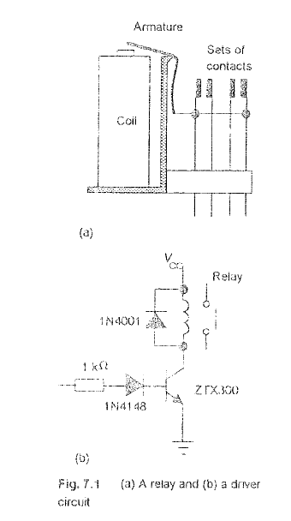
RELAYS

Slide 35
SOLID STATE SWITCHES

Slide 36
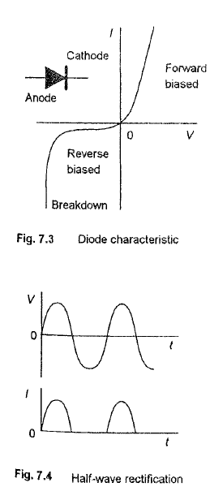
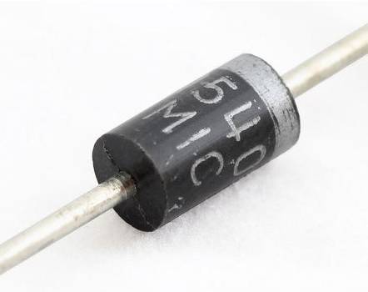
DIODES
It is a semiconductor device with two terminals, typically allowing the flow of current in one direction only.
a thermionic valve having two electrodes (an anode and a cathode).

Slide 37
THYRISTOR
Functions a little like a transistor
It consists of three electrodes: the gate, the anode and the cathode.
The gate acts as the controlling electrode.
When a small current flows into the gate, it allows a larger current to flow from the anode to the cathode.
A thyristor can be switched from a blocking state (high voltage, low current) to a conducting state (low voltage, high current) by a suitable gate pulse.

Slide 38
TRIAC
A thyristor is analogous to a relay in that a small voltage and current can control a much larger voltage and current.
The illustration on the right shows the circuit symbol for a TRIAC where A1 is Anode 1, A2 is Anode 2, and G is Gate. Anode 1 and Anode 2 are normally termed Main Terminal 1 (MT1) and Main Terminal 2 (MT2) respectively.
It is widely used in power control and switching applications
It finds applications in switching, phase control, brilliance control in lamps, speed control in fans, motors etc.

Slide 39
BIPOLAR TRANSISITOR

Slide 40
Power MOSFET
Three terminal device such as source, gate, and drain.
The MOSFET (Metal Oxide Semiconductor Field Effect Transistor) transistor is a semiconductor device
Used for switching and amplifying electronic signals in the electronic devices.

Slide 41
As the voltage on the gate increases (either positively or negatively, depending on whether the channel is made of P-type or N-type semiconductor material), the channel conductivity decreases.
The second way in which a MOSFET can operate is called enhancement mode .
BJTs are preferred for low current applications, while MOSFETs are for high power functions.

Slide 42
SOLENOID
When current is passes through a coil of soft iron core is pulled into the coil and in doing so, can open or close the ports to allow the flow of fluids.
Electrically operated actuators
Used to control flow in hydraulics and pneumatics

Slide 43
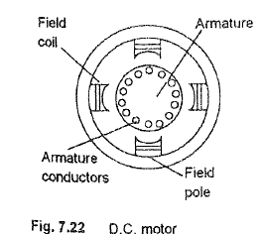
Construction and working principle of DC Motors
Construction of DC Motor:
It consists of
Armature
Armature conductors
Field coil
Field pole

Slide 44
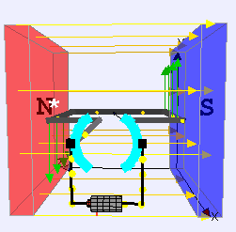
Working principle of DC Motors:
"whenever a current carrying conductor is placed in a magnetic field, it experiences a mechanical force".
The direction of this force is given by Fleming's left hand rule and it's magnitude is given by F = BIL. Where, B = magnetic flux density, I = current and L = length of the conductor within the magnetic field.

Slide 45
Types Of DC Motors
Separately excited (field winding is fed by external source)
Self excited -
Series wound (field winding is connected in series with the armature)
Shunt wound (field winding is connected in parallel with the armature)
Compound wound -
Long shunt
Short shunt

Slide 47
Construction and working principle of AC Motors
Construction of AC Motor:
It consists of
Rotor
Stator
Poles
Classified into 2 types:
Single- Phase (Low Power)
Multi-Phase (High Power)
Further classified into induction (cheaper) and synchronous motor
Synchronous motor have the rotor as permanent magnet
It is not self started

Slide 48
Working principle of AC Motors:
Alternating flux is produced around the stator winding due to AC supply.
This alternating flux revolves with synchronous speed. The revolving flux is called as "Rotating Magnetic Field" (RMF).
The relative speed between stator RMF and rotor conductors causes an induced emf in the rotor conductors, according to the Faraday's law of electromagnetic induction.
The rotor conductors are short circuited, and hence rotor current is produced due to induced emf. That is why such motors are called as induction motors.

Slide 49
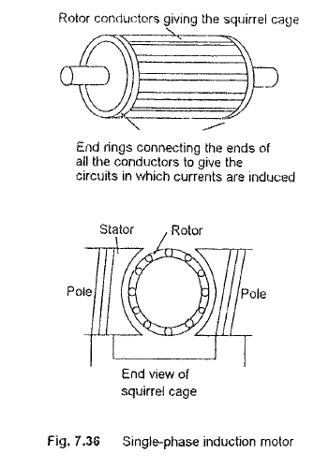
Types Of AC Motors

Slide 50
Speed control of AC and DC drives
Speed Control From Stator Side
By Changing The Applied Voltage:
By Changing The Applied Frequency
Constant V/F Control Of Induction Motor
Changing The Number Of Stator Poles
Speed Control From Rotor Side
Rotor Rheostat Control
Cascade Operation
By Injecting EMF In Rotor Circuit

Slide 51
Stepper Motors
Stepper motors are DC motors that move in discrete steps.
They have multiple coils that are organized in groups called "phases".
By energizing each phase in sequence, the motor will rotate, one step at a time.
With a computer controlled stepping you can achieve very precise positioning and/or speed control.
Stepper motors come in many different sizes and styles and electrical characteristics. This guide details what you need to know to pick the right motor for the job.

Slide 52
Types of Stepper Motors
Variable reluctance stepper motor
Permanent magnet stepper motor
Hybrid stepper motor

Slide 53
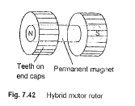

Slide 54
Switching circuitries for stepper motor
Unipolar Stepper Driver Circuit
Bipolar Stepper driver circuit
Integrated circuit for stepper motor

Slide 55
AC & DC Servomotors
A servo motor is a linear or rotary actuator that provides fast precision position control for closed-loop position control applications.
Unlike large industrial motors, a servo motor is not used for continuous energy conversion.
Servo motors have a high speed response due to low inertia and are designed with small diameter and long rotor length.

Slide 56
Types of Servo motor
AC Servomotor- used more often due to their high accuracy control.
DC Servomotor- simple applications owing to their cost, efficiency and simplicity.

Slide 57
DC Servo motor

Slide 58
AC Servomotor
Induction-type AC servo motor
Synchronous-type AC servo motor

Slide 59
