Slide 1
UBMC703- MECHATRONICS
OBJECTIVES:
To learn the Applications of Fluid Power System in automation of Machine Tools and others equipment‘s

Slide 2
UNIT 1:MECHATRONICS, SENSORS AND TRANSDUCERS
Introduction to Mechatronics Systems – Measurement Systems – Control Systems – Microprocessor based Controllers. Sensors and Transducers – Performance Terminology – Sensors for Displacement, Position and Proximity; Velocity, Motion, Force, Fluid Pressure, Liquid Flow, Liquid Level, Temperature, Light Sensors – Selection of Sensors

Slide 3
UNIT 2: ACTUATION SYSTEMS
Pneumatic and Hydraulic Systems – Directional Control Valves – Rotary Actuators. Mechanical Actuation Systems – Cams – Gear Trains – Ratchet and pawl – Belt and Chain Drives – Bearings. Electrical Actuation Systems – Mechanical Switches – Solid State Switches – Solenoids – Construction and working principle of DC and AC Motors – speed control of AC and DC drives, Stepper Motors-switching circuitries for stepper motor – AC & DC Servo motors.

Slide 4
UNIT 3: SYSTEM MODELS AND CONTROLLERS
Building blocks of Mechanical, Electrical, Fluid and Thermal Systems, Rotational – Transnational Systems, Electromechanical Systems – Hydraulic – Mechanical Systems. Continuous and discrete process Controllers – Control Mode – Two – Step mode – Proportional Mode – Derivative Mode – Integral Mode – PID Controllers – Digital Controllers – Velocity Control – Adaptive Control – Digital Logic Control – Micro Processors Control

Slide 5
UNIT 4: PROGRAMMING LOGIC CONTROLLERS
Programmable Logic Controllers – Basic Structure – Input / Output Processing – Programming – Mnemonics – Timers, Internal relays and counters – Shift Registers – Master and Jump Controls – Data Handling – Analogs Input / Output – Selection of a PLC

Slide 6
UNIT 5: DESIGN OF MECHATRONICS SYSTEM
Stages in designing Mechatronics Systems – Traditional and Mechatronic Design – Possible Design Solutions. Case studies of Mechatronics systems- Pick and place Robot- Autonomous mobile robot Wireless suriviellance balloon- Engine Management system- Automatic car park barrier.

Slide 7
UNIT 1:MECHATRONICS, SENSORS AND TRANSDUCERS
Introduction to Mechatronics Systems
Mechatronics:
It is the study that implies the synergistic integration of electronic engineering, electrical engineering, control engineering and computer technology with mechanical engineering for the design, manufacture, analyse and maintenance of a wide range of engineering products and processes

Slide 8
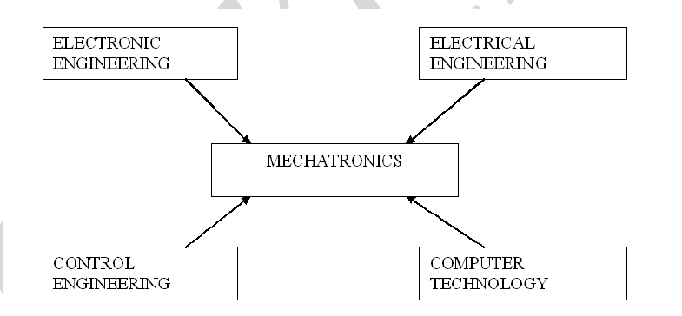

Slide 9
System
A system may be defined as a black box which has an input and an output.

Slide 10
Mechatronic System

Slide 11
Actuators:
Solenoids, voice coils, D.C. motors, Stepper motors, Servomotor, hydraulics, pneumatics.
Sensors:
Switches, Potentiometer, Photoelectrics, Digital encoder, Strain gauge, Thermocouple, accelerometer etc.
Input signal conditioning and interfacing:
Discrete circuits, Amplifiers, Filters, A/D, D/D.
Digital control architecture:
Logic circuits, Microcontroller, SBC, PLC, Sequencing and timing, Logic and arithmetic, Control algorithm, Communication.
Output signal conditioning and interfacing:
D/A D/D, Amplifiers, PWM, Power transistor, Power Op - amps.
Graphical displays: LEDs, Digital displays, LCD, CRT

Slide 12
MEASUREMENT SYSTEM
A measurement system can be defined as a black box which is used for making measurements.
It has the input as the quantity being measured and the output as a measured value of that quantity.

Slide 13
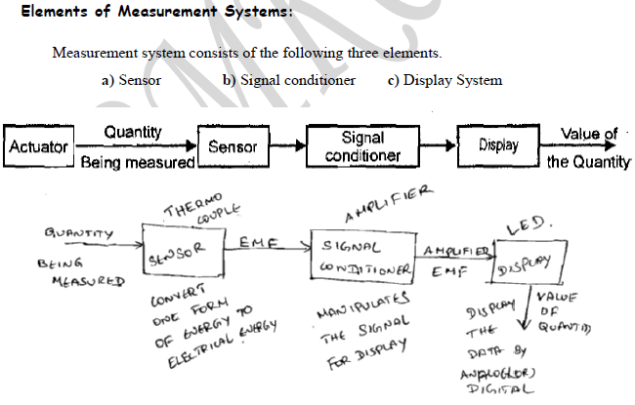

Slide 14
Sensor:
A sensor consists of transducer whose function is to convert the one form of energy into electrical form of energy.
Signal Conditioner:
A signal conditioner receives signal from the sensor and manipulates it into a suitable condition for display.

Slide 15
Display System:
A display system displays the data (output) from the signal conditioner by analog or digital. A digital system is a temporary store such as recorder.

Slide 16
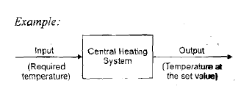
Control System
A black box which is used to control its output in a pre-set value.
Eg: Air- Conditioner

Slide 17
OPEN LOOP CONTROL SYSTEM
If there is no feedback device to compare the actual value with desired one.
No control over its input.

Slide 18
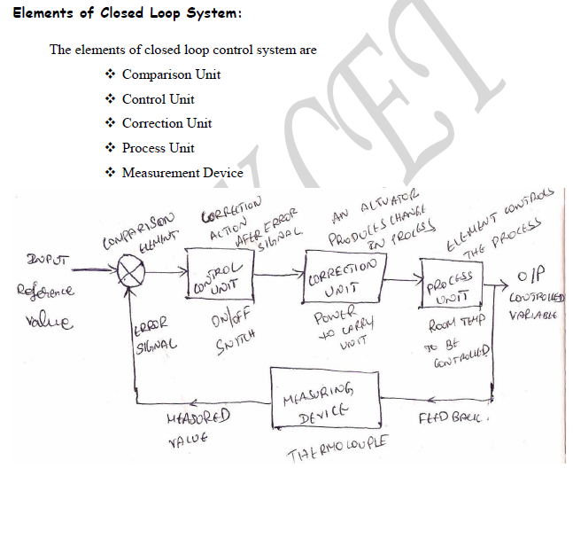
CLOSED LOOP CONTROL SYSTEM
If there is feedback device to compare the actual value with desired one.

Slide 19
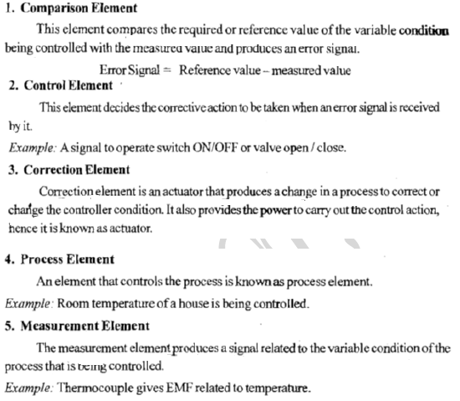

Slide 20
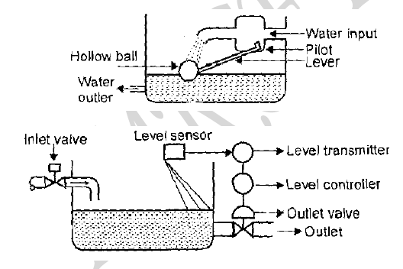
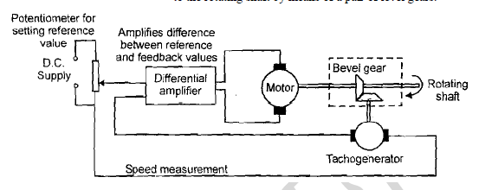
EXAMPLES
System of Controlling Room Temperature
System of Controlling Water Level
Automatic Speed Control of Rotating Shaft

Slide 21
MICROPROCESSOR BASED CONTROLLERS (SEQUENTIAL CONTROLLERS)
It is used to control the process that are strictly ordered in a time or sequence.
Eg: Domestic Washing Machine
Operations:
Pre Wash Cycle
Main Wash Cycle
Rinse Cycle
Spinning Cycle

Slide 23
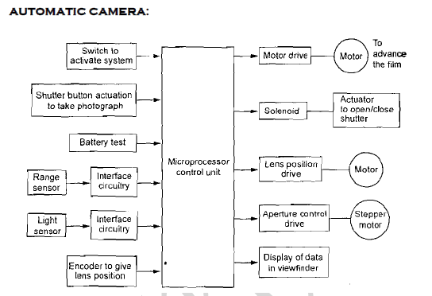

Slide 24
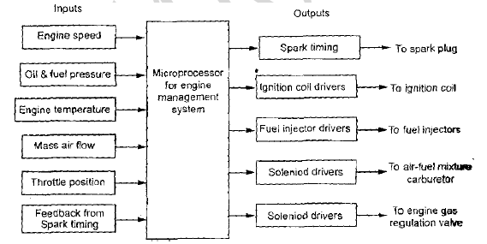

Slide 25
SENSORS
Transducers:
It is an element which is subjected to physical change experience a related change.
Example: Tactile Sensors.
Sensors:
It is an element which is not subjected to physical change experience a related change.
Example: LVDT

Slide 26
PERFORMANCE TERMINOLOGY
Static Characteristics:
Range and Span:
The range of a transducer defines the limits between which the input can vary.
The difference between the limits (maximum value - minimum value) is known as span.
For example a load cell is used to measure force. An input force can vary from 20 to 100 N.
Then the range of load cell is 20 to 100 N.
The span of load cell is 80 N (i.e., 100-20)

Slide 27
Error:
Error = Indicated value — true value
For example, if the transducer gives a temperature reading of 30°C when the actual temperature is 29° C, then the error is + 1°C. If the actual temperature is 31° C, then the error is — 1°C.
Accuracy:
It is defined as the ability of the instrument to respond to the true value of the measure variable under the reference conditions.
For example, a thermocouple has an accuracy of ± 1° C. This means that reading given by the thermocouple can be expected to lie within + 1°C (or) — 1°C of the true value.

Slide 28
Sensitivity:
The sensitivity is the relationship showing how much output we can get per unit input.
Sensitivity = Output / Input
Precision:
It is defined as the degree of exactness for which the instrument is intended to perform.

Slide 29
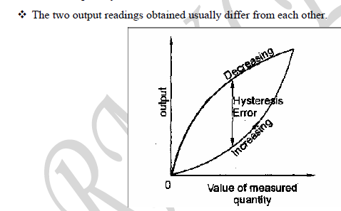
Hysteresis error:
When a device is used to measure any parameter plot the graph of output Vs value of measured quantity.
First for increasing values of the measured quantity and then for decreasing values of the measured quantity.

Slide 30
Repeatability:
It is the ability to give the same output for repeated applications of the same input value.
Reliability:
It is defined as the possibility that it will perform its assigned functions for a specific period of time under given conditions.
Stability:
It is the ability to give the same output when used to measure a constant input over a period of time.

Slide 31
Drift:
It is the change in output that occurs over time.
Dead band:
There will be no output for certain range of input values. This is known as dead band.
Dead time:
It is the time required by a transducer to begin to respond to a change in input value.
Resolution:
It is defined as the smallest increment in the measured value that can be detected.

Slide 32
Backlash:
It is defined as the maximum distance (or) angle through which any part of a mechanical system can be moved in one direction without causing any motion of the attached part.
Eg: Gears

Slide 33
SELECTION OF DISPLACEMENT, POSITION & PROXIMITY SENSOR
Size of the displacement (mm)
Displacement type (Linear or angular)
Resolution required
Accuracy Required
Material of the object
Cost
Displacement sensors are contact type sensor

Slide 34
Types of Displacement sensors:
Potentiometer
Strain gauge
Capacitive sensors
Linear variable differential transformer

Slide 35
Potentiometer

Slide 36
It works on variable resistance transduction principle
It consists of an resistance element with a sliding contact which can be moved over the length of the element. such elements can be used for linear or rotary displacements, the displacement being converted into a potential difference.

Slide 37
STRAIN GAUGE
The electrical resistance strain gauge is a metal wire, metal foil strip or a strip of semiconductor material which is wafer- like and can be stuck onto surfaces like a postage stamp. When subject to strain, its resistance R changes, the fractional change in resistance ∆R/ R being proportional to strain ₤, i.e.
∆R/ R= G. ₤
G- Constant of Proportionality

Slide 40
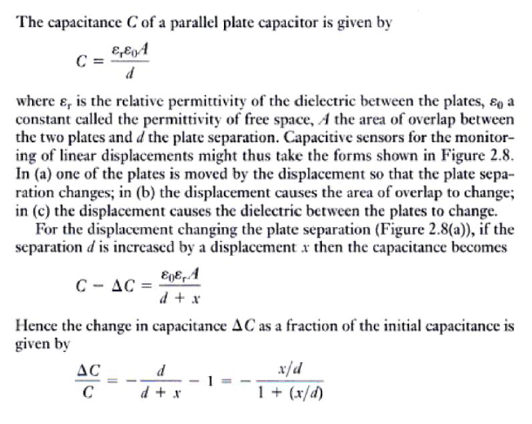
CAPACITIVE SENSORS

Slide 41
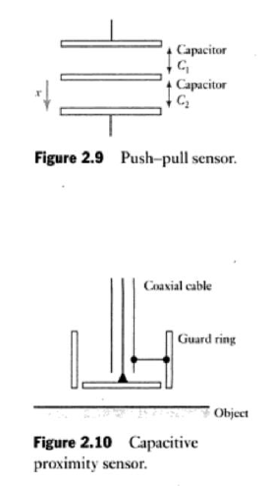

Slide 42
LINEAR VARIABLE DIFFERENTIAL TRANSFORMER
It consists of three symmetrically spaced coils.
The centre coil is primary coil and other two are secondary coil
Secondary coils are connected in series opposition and equally positioned with respect to primary coil
The output voltage is proportional to the displacement of the core from null position

Slide 43
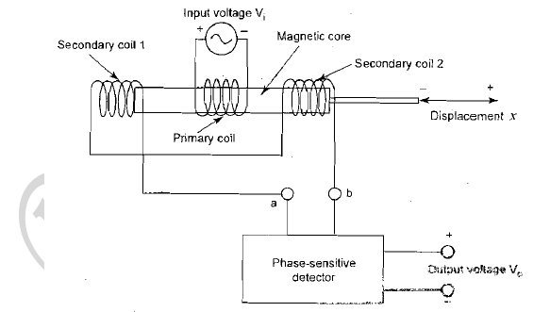

Slide 44
PROXIMITY SENSORS
Proximity sensors are non – contact type sensor.
Types of Proximity Sensor:
Eddy current proximity sensor
Inductive proximity sensor
Pneumatic proximity sensor
Proximity switches

Slide 45
EDDY CURRENT PROXIMITY SENSOR
When a coil is supplied with alternating current, an alternating magnetic field is produced which induces an EMF on it.
If there is a metal near to this alternating magnetic field, on EMF is induced in it. The EMF cause current to flow. This current flow is eddy current.

Slide 46
INDUCTIVE PROXIMITY SENSORS
It consists of coil wound round a core.
Metal is close to coil Inductance changes occurs.
It is suitable for ferrous metals

Slide 47
PNEUMATIC PROXIMITY SENSOR
It is suitable for sensing non conducting materials .
When there is an object, the escaping air is blocked and return backed to system.
It is used to measure the range 3mm to 12mm.

Slide 48
PROXIMITY SWITCHES
It is used in robotics for sensing elements
It is also used in NC machines, material handling systems and assembly lines.
Micro switch
Reed switch
Photo sensitive switch
Mechanical switch

Slide 49
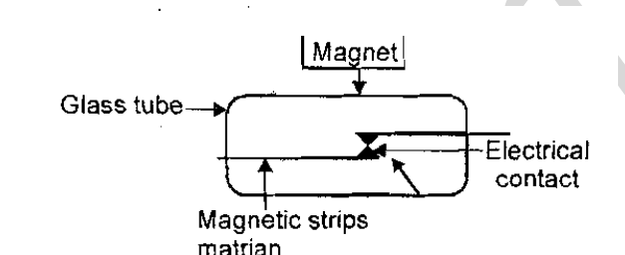
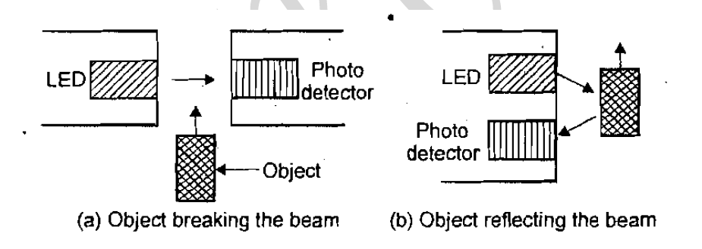
MICRO SWITCH
REED SWITCH
PHOTO SENSITIVE DEVICES

Slide 50
HALL EFFECT SENSORS
When a current carrying semiconductor plate is placed in a transverse magnetic field, it experiences a force (Lorentz force).
Due to this action a beam of charged particles are forced to get displaced from its straight path. This is known as Hall Effect.

Slide 51
VELOCITY AND MOTION SENSORS OPTICAL ENCODERS
Measure the angular velocity
Determine the number of pulse produced per second

Slide 52
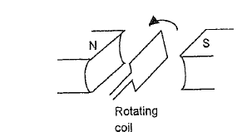
TACHOGENERATOR
Measure angular velocity
It consists of toothed wheel of ferromagnetic material, which is attached to the rotating shaft
A pick- up coil is wound on a permanent magnet
As a wheel rotates, so the teeth move past the coil and the air gap between coil and the ferromagnetic material changes. The magnetic circuit changes periodically resulting flux changing linked produces an e.m.f in the coil.

Slide 54
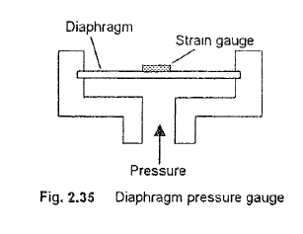
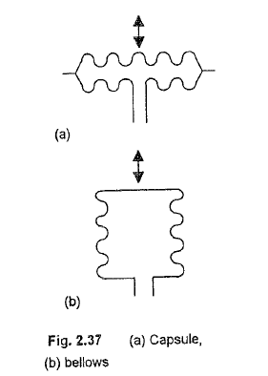
FLUID PRESSURE

Slide 56
PIEZOELECTRIC SENSORS
When stretched or compressed generate electric charges with one face of the managerial becoming positively charged and the opposite face negatively charged.
As a result a voltage is produced. The net charge q on a surface is proportional to the amount x by which the charges have been displaced, and since the displacement is proportional to the applied force F.
q = kx= SF
Where , k- Constant
S- Constant termed the charge sensitivity

Slide 57
TACTILE SENSOR
It is used on fingertips of robot hands and for touch display screen
It uses piezoelectric polyvinylidene fluoride (PVDF) film
Two layers are separated by sift film
The lower PVDF film has an alternating voltage applied to it results in mechanical oscillations
Intermediate film transmits the vibration to upper film

Slide 58
LIQUID FLOW SENSORS

Slide 59
ORIFICE PLATE
It is a simple disc with a central hole and it is placed in the tube through which the fluid flows.
The pressure difference measured between a point equal to the diameter of the tube upstream and half the diameter of downstream.
The accuracy of this instrument is ±1.5%.

Slide 60
TURBINE FLOW METER
The turbine flow meter and it consists of a multi-bladed rotor which is supported in the pipe along with the flow occurs.
The rotor rotation depends upon the fluid flow and the angular velocity is proportional to the flow rate.
The rotor rotation is determines the magnetic pick-up, which is connected to the coil.
The revolution of the rotor is determined by counting the number of pulses produced in the magnetic pick up.
The accuracy of this instrument is ± 3%.

Slide 61
LIQUID LEVEL
In this method the level of liquid is measured by movement of a float.
The movement of float rotates the arm and slider will move across a potentiometer.
The output result is related to the height of the liquid.

Slide 62
DIFFERENTIAL PRESSURE SENSOR
The differential pressure cell determines the pressure difference between base of the liquid and atmospheric pressure.
The differential pressure sensor can be used in either form of open or closed vessel system

Slide 63
TEMPERATURE SENSOR
A Bimetallic thermostat consists of two different metal strips bounded together and they cannot move relative to each other.
These metals have different coefficients of expansion and when the temperature changes the composite strips bends into a curved strip, with the higher coefficient metal on the outside of the curve.
The basic principle in this is all metals try to change their physical dimensions at different rates when subjected to same change in temperature.

Slide 65
RESISTANCE TEMPERATURE DETECTORS (RTDS)
The materials used for RTDs are Nickel, Iron, Platinum, Copper, Lead, Tungsten, Mercury, Silver, etc.
The resistance of most metals increases over a limited temperature range and the relationship between Resistance and Temperature is shown below.

Slide 67
THERMISTOR
Thermistor is a semiconductor device that has a negative temperature coefficient of resistance in contrast to positive coefficient displayed by most metals.
Thermistors are small pieces of material made from mixtures of metal oxides, such as Iron, cobalt, chromium, Nickel, and Manganese.
The shape of the materials is in terms of discs, beads and rods.
The thermistor is an extremely sensitive device because its resistance changes rapidly with temperature.

Slide 68
THERMOCOUPLE
The thermocouple is a temperature measuring device.
It uses for measuring the temperature at one particular point.
In other words, it is a type of sensor used for measuring the temperature in the form of an electric current or the EMF.

Slide 69
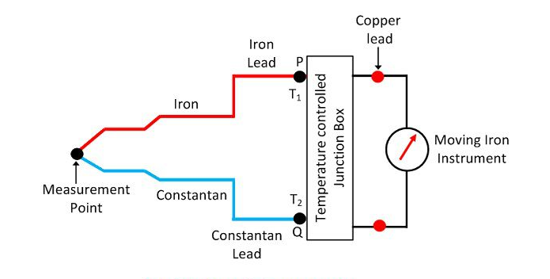

Slide 70
LIGHT SENSORS
A photodiode is one type of light detector, used to convert the light into current or voltage based on the mode of operation of the device.
It comprises of optical filters, built-in lenses and also surface areas.
These diodes have a slow response time when the surface area of the photodiode increases.

Slide 71
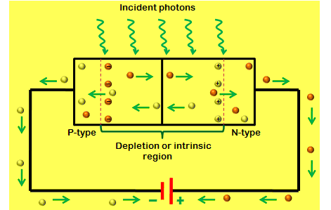
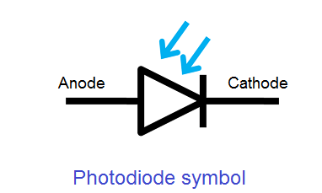

Slide 72
APPLICATIONS
Smoke detectors, compact disc players, and televisions and remote controls in VCRs.
Photodiodes are frequently used for exact measurement of the intensity of light in science & industry.
Photodiodes are also widely used in numerous medical applications like instruments to analyze samples, detectors for computed tomography and also used in blood gas monitors.

Slide 73
SELECTION OF SENSORS
Nature of measurement required (variables to be measured, range of values, accuracy required, reliability required and environmental conditions under which measurement to be made)
Nature of the output required from the sensor
Possible sensors can be identified (range, accuracy, linearity, speed of response, reliability, maintainability and life)

